Slide 1

Year Four Multiplication Check.
Parents information

Slide 2
Why are times tables important?
Times tables are fundamental within maths and children will find that they underpin many areas within Maths. It is a real advantage when children can recall their multiplication facts up to 12 x 12 especially when they are needed to solve more complex problems.
The purpose of the check is to determine whether your child can fluently recall their times tables up to 12 x 12. Knowing the multiplication facts up to 12x 12, will give them the essential knowledge needed to be proficient with the Key Stage 2 maths curriculum and beyond.

Slide 3
What does the multiplication check involve?
It is an on-screen check consisting of 25 times table questions. Your child will be able to answer 3 practice questions before taking the actual check. They will then have 6 seconds to answer each question. On average, the check should take no longer than 5 minutes to complete.

Slide 4
Example- this is very similar to the NTC.
https://mathsframe.co.uk/en/resources/resource/477/Multiplication-Tables-Check

Slide 5
When is it?
The times table check is a test for all year four pupils across the country that takes place between Monday 5th June and Friday 16th June 2023.

Slide 6
Will I find out my child’s score?
Your child’s teacher will share your child’s score with you, as they would with all national curriculum assessments. There is no current pass mark for the check, however, we know our children here at Horsted will strive to achieve their best.

Slide 7
Access for all children.
There are several access arrangements available for the check, these can be used to support pupils with specific needs. Your child’s teacher will ensure that the access arrangements are appropriate for your child before they take the check in June. The check has been designed so that it is inclusive and accessible to as many children as possible, including those with special educational needs or disability (SEND) or English as an additional language (EAL).

Slide 8

What can I do to support my child?
We practise our timetables daily at school and our school’s expectation is that your child practises them at home too.
Encourage children to play Times table Rockstars as often as possible. Small 5 minute daily sessions will help children to learn times tables more than one long session a week.
The soundcheck is very similar to the multiplication check.
Quiz your child at home regularly. This could be when making dinner or
on the journey to school.

Slide 9
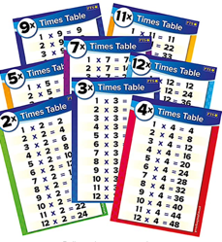
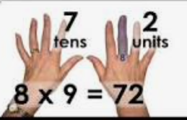
What can I do to support my child?
Display a poster with all of the times tables facts on at home.
We teach lots of tricks to help the children remember
the times tables. You could learn a trick together.
Create flash cards with your children and let them play with friends, siblings, grandparents. They could write the answer on the back and test themselves.

Slide 10
What can I do to support my child?
We use lots of songs to teach our times tables in school. Children will be able to find many of these on YouTube and sing along to them at home. Children could also make their own times tables songs.
Chanting their times table is an excellent way to learn them. They could do this each time they walk up the stairs.
Any times tables practise that the children can do at home will really support them to become proficient in their times tables and help them with their everyday maths learning.

Slide 11
We value your support. Thank you for supporting us.

