Slide 1
Welcome
End of Key Stage One Assessments

Slide 2
Aims
What are SATs?
An outline of the tests
Teacher assessment
The results
What you can do to help
Individual children will not be discussed.

Slide 3
What are end of kS1 assessments?
What you might know as SATs or Standard Attainment Tests, are national curriculum tests that are usually taken by children at the end of key stage one.
These are just part of the picture.
All children are assessed during the last term of year 2 to judge what they have learned over the course of key stage one (years 1 and 2).
Teachers judge whether each child in their class has achieved the expected standards for the end of key stage one.
Teachers will use a range of evidence to support their judgements, including the children’s results in their national curriculum tests, as well as independent work in class.
Teachers will judge what a child is able to do independently and align this with the national expectations for a child at the end of key stage one.

Slide 4
What subjects are included?
At the end of Year 2, children will take assessments in:
  Reading
  Maths
  Grammar, Punctuation and Spelling
All assessment are due to take place in May this year.
Science teacher assessment is based on work completed during Year 1 and Year 2.
Tests are marked internally. Judgements will be moderated by the LA
Overall judgement is still based on teacher assessment

Slide 5
How are the assessments carried out?
Children will not know that they are taking tests, done as subtly as possible.
We do not call them tests, exams, SATs – often called ‘special work’
NO pressure is put on the children as they are 6/7 years old!
Small groups taken to work in a quiet and calm space.
Government given teachers a time guideline but at KS1 this is not strictly adhered to.

Slide 6
When are they carried out?
Throughout May.
Please try to make sure your child has regular attendance through that time (unless they are very unwell!)
During the normal school day.

Slide 7
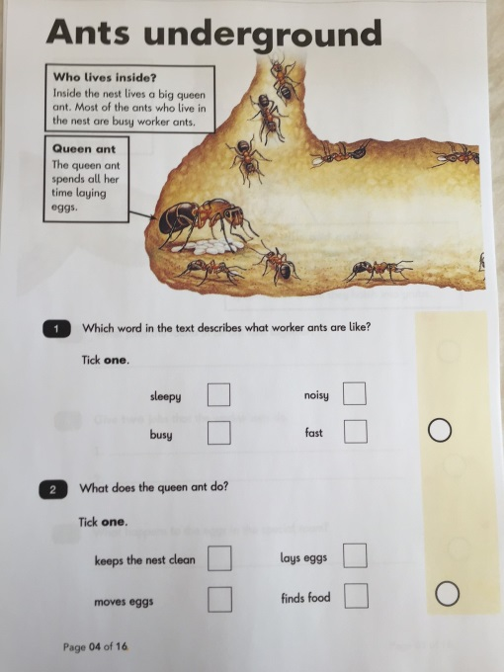
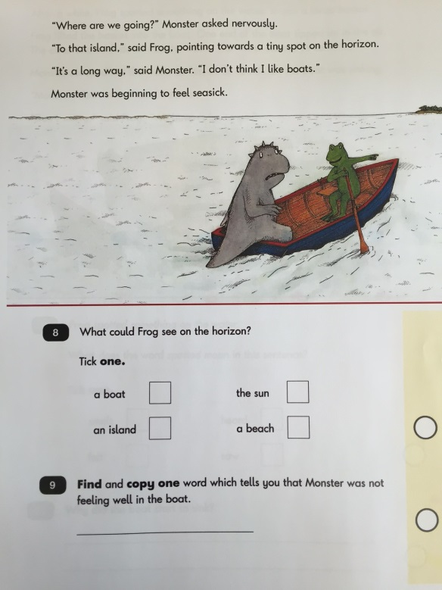

Reading Test – Paper 1
30 minutes approximately
20 marks
Likely to be a mix of fiction and
non-fiction.
Children to read and answer
straightforward questions – either
multiple choice or write a sentence.
Later questions involve children
making inferences.
Can use the text to find answers.

Slide 8
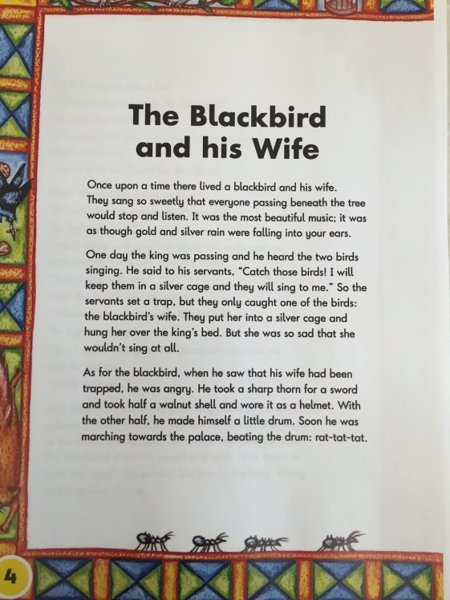
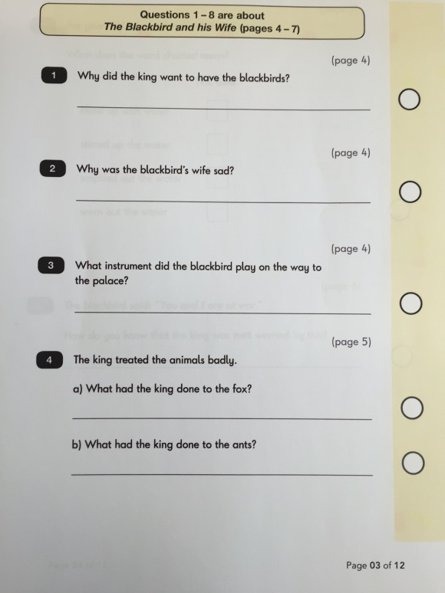
Reading Test – Paper 2
40 minutes approximately
20 marks
All children will sit a 2nd reading
paper which will contain a longer,
more challenging text.
2 booklets – 1 with the text, 1 with
questions in.
Likely to be fiction and non-fiction.
Questions will focus on 2 main areas
of KS1 reading – explaining their
understanding of the words they’ve read
and retrieving information from the text.

Slide 9
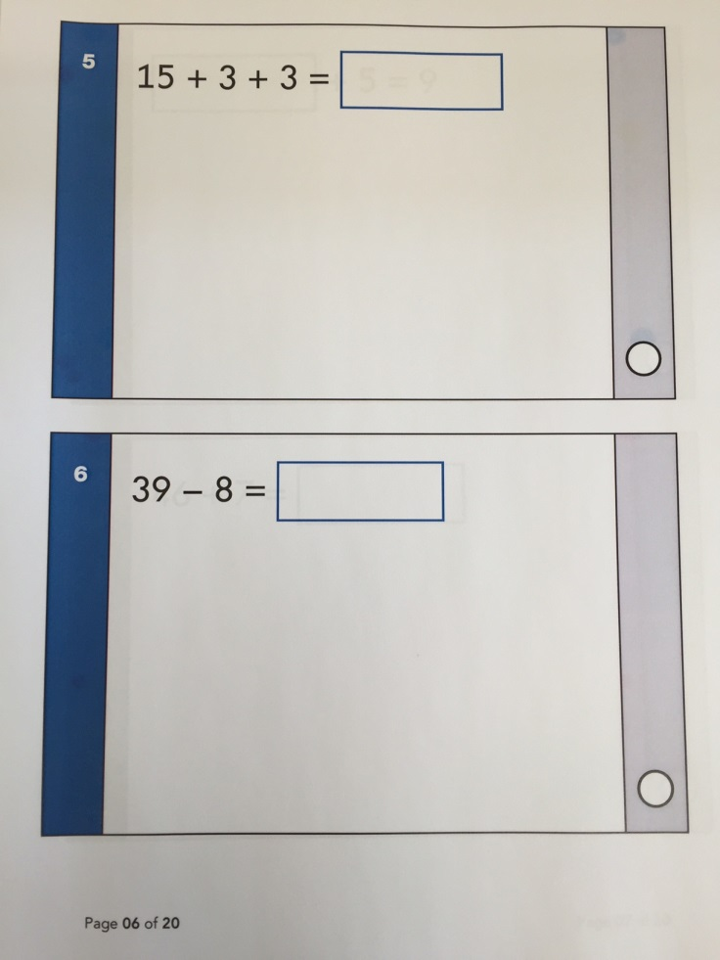
Arithmetic Test
20 minutes approximately
25 marks
Children are given various calculations
to work out with space for jottings,
pictures.
Questions rely on children’s basic
knowledge of number facts.
Later questions will involve division
and fractions.

Slide 10
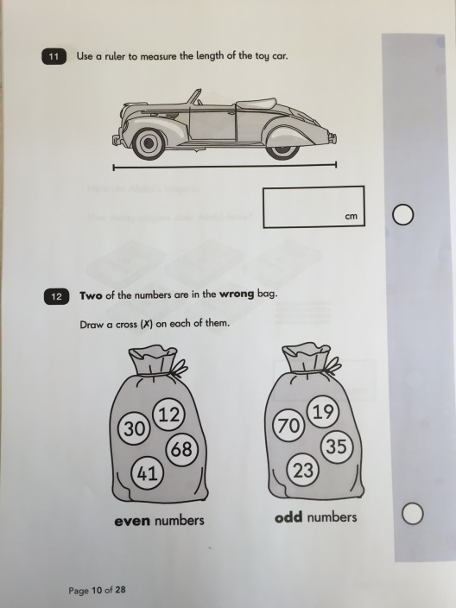
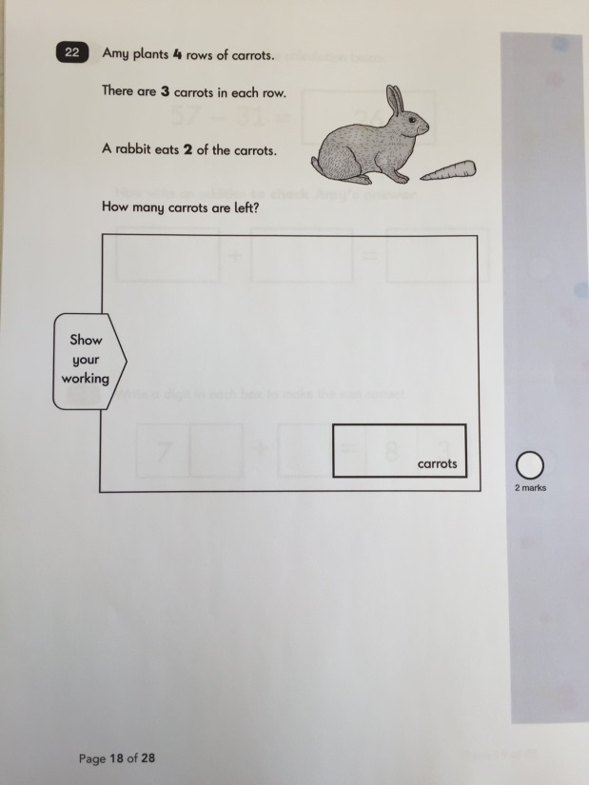
Maths Reasoning Test
35 minutes approximately
35 marks
Each question comes with a context
and a drawing or diagram.
Questions require either a tick in a
box, write a short answer or select
an answer.
Later questions will require children
to show how they would work out
an answer.

Slide 11
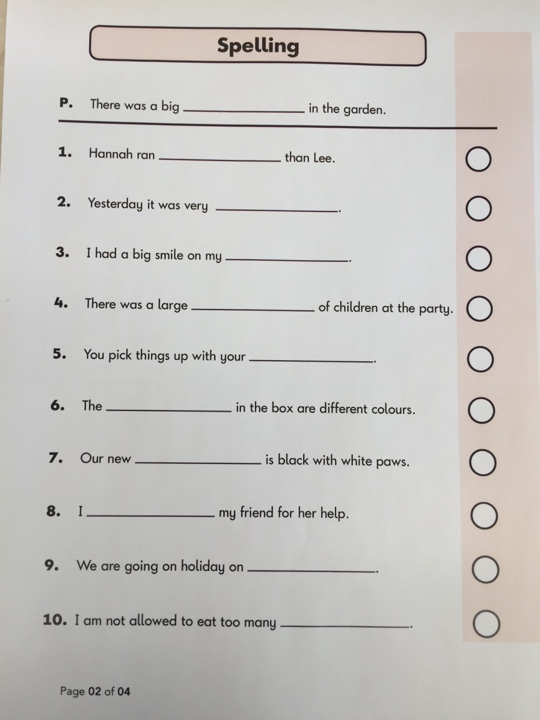
Spelling Test
15 minutes approximately
20 marks
20 words from KS1 curriculum.
Read as part of a sentence.
Words get harder as test goes along.
Easier ones to start following
spelling patterns.
Harder ones require children to
know spelling rules such as the plural
of teddy is teddies – take off y and
add –ies ending.

Slide 12
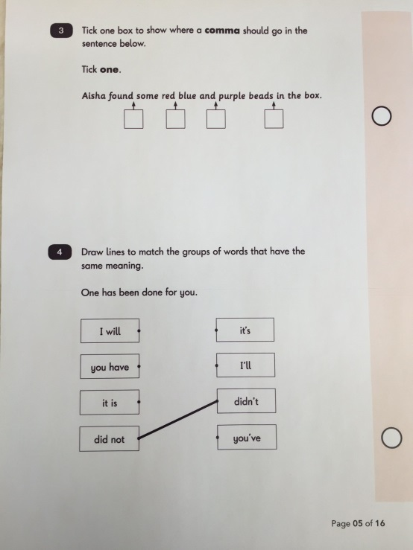
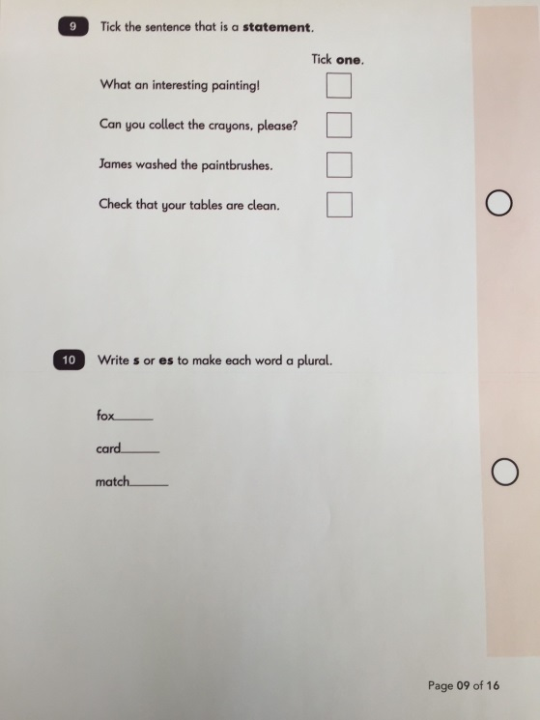
Grammar & Punctuation Test
20 minutes approximately
20 marks
Tests various aspects of grammar
and punctuation.
Children knowing about verbs, nouns,
adjectives, adverbs.
Past and Present Tense.
Types of sentence – command, question,
exclamation, statement.
Using different types of punctuation correctly.
Combined score from spelling test and Grammar & Punctuation tests
are used to aid teachers making a judgement on children’s writing.

Slide 13
Writing
No formal tests.
All teacher assessment based on classwork and independent writing tasks.

Slide 14
Reporting Results
Tests marked by the teacher.
Convert the test scores into a ‘standardised score’ using government provided document.
100 represents the expected standard for KS1.
Children may score above and below the 100.
Conversion tables not released until June.
130
120
110
100
90
80
70
100 is the ‘expected standard’

Slide 15
Teacher Assessment
The test results will be used to inform teacher judgements.
At this point in time, teacher assessment can be used to make a judgement on a child rather than solely taking the test result.
Teachers will look at the evidence from the children’s daily work throughout the year and assess it against a framework – tick list criteria.

Slide 16
The Results
Results of Teacher Assessment judgements are reported to the LA.
An overall result will be made available to you with yearly reports.
Score will let you know where they are working at against the expected standard.
Subject | Teacher Assessment
Reading | Working at the expected standard
Writing | Working at the expected standard
Mathematics | Working at the expected standard

Slide 17
HOW TO HELP YOUR CHILD
chapter
menu
click to see all text
next page
First and foremost, support and reassure your child that there is nothing to worry about and that they should always just try their best. Praise and encourage!
Ensure your child has the best possible attendance at school.
Support your child with any homework tasks.
Reading, spelling and arithmetic (e.g. times tables) are always good to practise.
Talk to your child about what they have learnt at school and what book(s) they are reading (the character, the plot, their opinion).
Make sure your child has a good sleep and healthy breakfast every morning!
First and foremost, support and reassure your child that there is nothing to worry about and that they should always just try their best. Praise and encourage!
Ensure your child has the best possible attendance at school.
Support your child with any homework tasks.
Reading, spelling and arithmetic (e.g. times tables) are always good to practise.
Talk to your child about what they have learnt at school and what book(s) they are reading (the character, the plot, their opinion).
Make sure your child has a good sleep and healthy breakfast every morning!

Slide 18
HOW TO HELP YOUR CHILD WITH MATHS
click to see all text
chapter
menu
next page
Play times tables games.
Play mental maths games including counting in different amounts, forwards and backwards.
Encourage opportunities for telling the time.
Encourage opportunities for counting coins and money e.g. finding amounts or calculating change when shopping.
Look for numbers on street signs, car registrations and anywhere else.
Look for examples of 2D and 3D shapes around the home.
Identify, weigh or measure quantities and amounts in the kitchen or in recipes.
Play games involving numbers or logic, such as dominoes, card games.
Play times tables games.
Play mental maths games including counting in different amounts, forwards and backwards.
Encourage opportunities for telling the time.
Encourage opportunities for counting coins and money e.g. finding amounts or calculating change when shopping.
Look for numbers on street signs, car registrations and anywhere else.
Look for examples of 2D and 3D shapes around the home.
Identify, weigh or measure quantities and amounts in the kitchen or in recipes.
Play games involving numbers or logic, such as dominoes, card games,
draughts or chess.

Slide 19
click to see all text
chapter
menu
next page
HOW TO HELP YOUR CHILD WITH READING
Enjoy stories together – reading stories to your child is equally as important as listening to your child read.
Read a little at a time but often, rather than rarely but for long periods of time!
Talk about the story before, during and afterwards – discuss the plot, the characters, their feelings and actions, how it makes you feel, predict what will happen and encourage your child to have their own opinions.
Look up definitions of words together – you could use a dictionary, the Internet or an app on a phone or tablet.
All reading is valuable – it doesn’t have to be just stories. Reading can involve anything from fiction and non-fiction, poetry, newspapers, magazines, football programmes, TV guides.
Visit the local library - it’s free!

Slide 20
click to see all text
next page
HOW TO HELP YOUR CHILD WITH WRITING
chapter
menu
Practise and learn weekly spelling lists – make it fun!
Encourage opportunities for writing, such as letters to family or friends, shopping lists, notes or reminders, stories or poems.
Write together – be a good role model for writing.
Encourage use of a dictionary to check spelling.
Allow your child to use a computer for word processing, which will allow for editing and correcting of errors without lots of crossing out.
Remember that good readers become good writers! Identify good writing features when reading (e.g. vocabulary, sentence structure, punctuation).
Show your appreciation: praise and encourage, even for small successes!
Practise and learn weekly spelling lists – make it fun!
Encourage opportunities for writing, such as letters to family or friends, shopping lists, notes or reminders, stories or poems.
Write together – be a good role model for writing.
Encourage use of a dictionary to check spelling.
Allow your child to use a computer for word processing, which will allow for editing and correcting of errors without lots of crossing out.
Remember that good readers become good writers! Identify good writing features when reading (e.g. vocabulary, sentence structure, punctuation).
Show your appreciation: praise and encourage, even for small successes!

Slide 21
EXAMPLE SATS QUESTIONS…

Slide 22
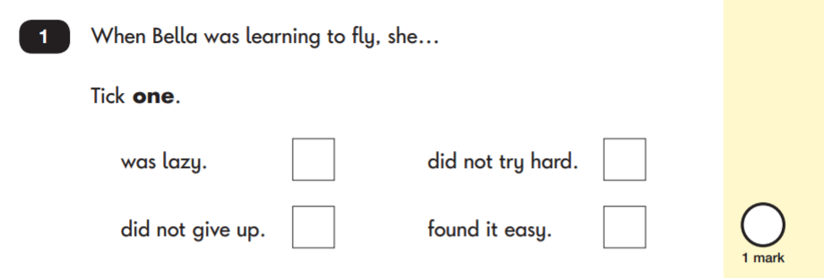
READING: SAMPLE QUESTIONS
Questions are designed to assess the comprehension and understanding of a child’s reading.
There are a variety of question types:
Multiple Choice
next page
chapter
menu

Slide 23
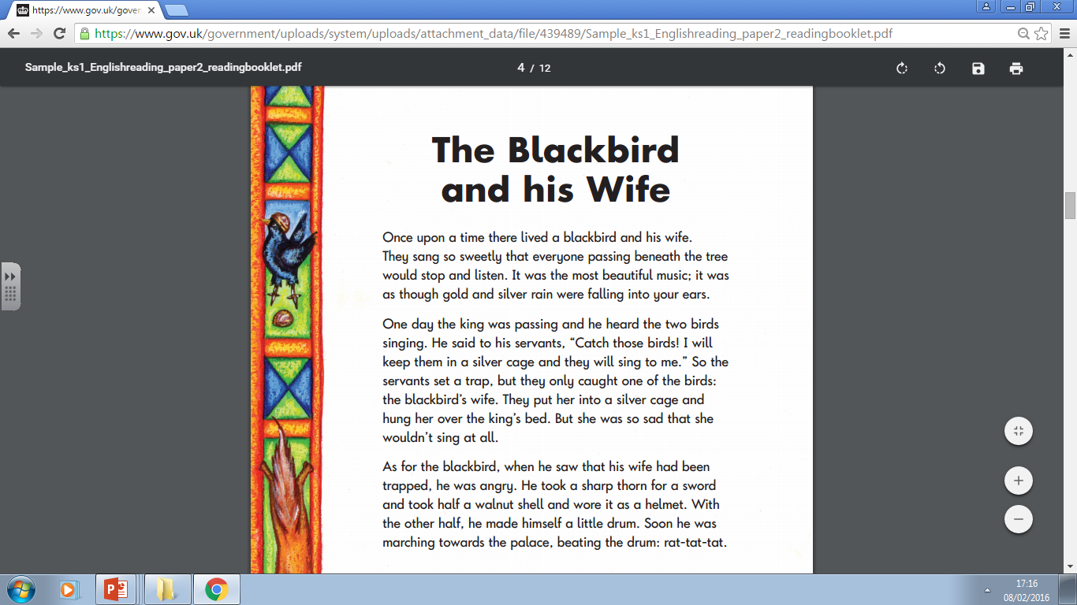
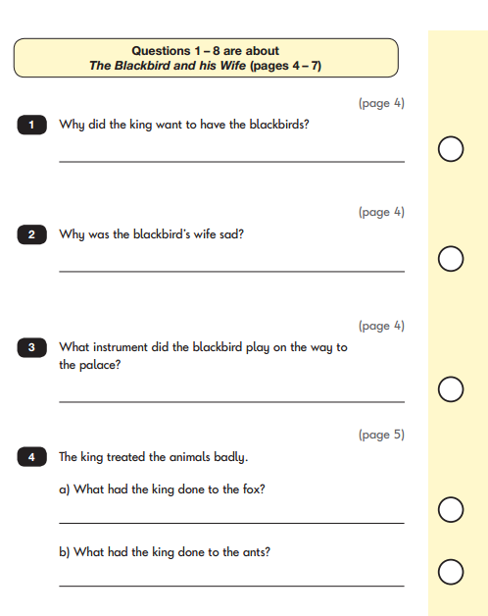
Paper 2

Slide 24
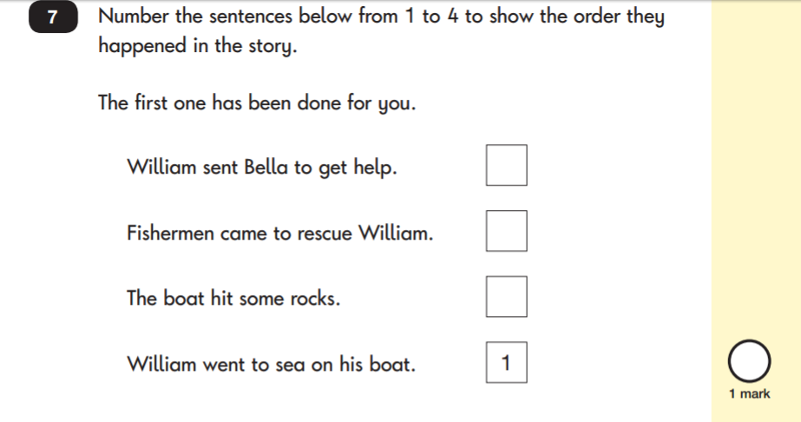
READING: SAMPLE QUESTIONS
Ranking/Ordering
next page
chapter
menu

Slide 25
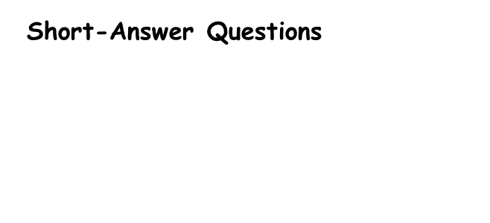
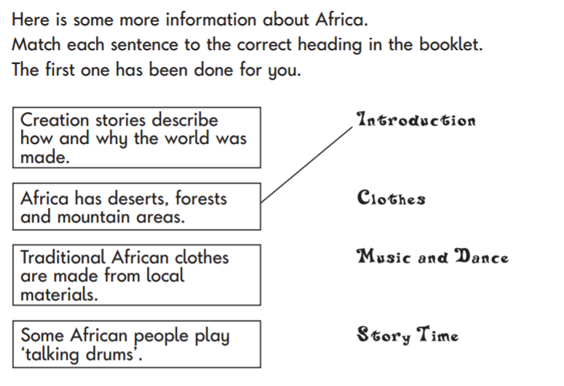
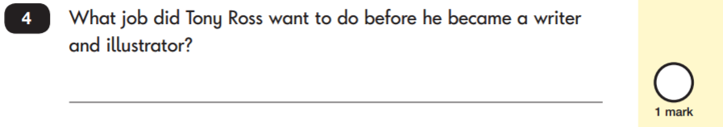
READING: SAMPLE QUESTIONS
next page
chapter
menu
Matching/Labelling
Short-Answer Questions

Slide 26
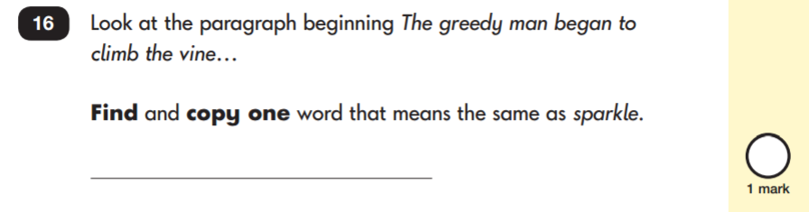
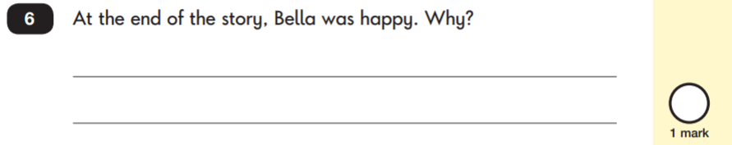
READING: SAMPLE QUESTIONS
Find and Copy Questions
Open-Ended Questions
click to see all text
next page
chapter
menu

Slide 27
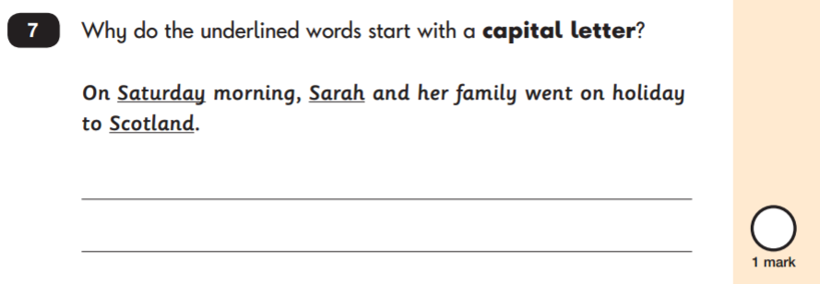
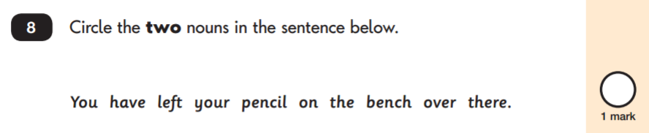
GRAMMAR, PUNCTUATION & SPELLING: SAMPLE QUESTIONS
Grammar, Punctuation and Vocabulary Paper
chapter
menu
next page

Slide 28
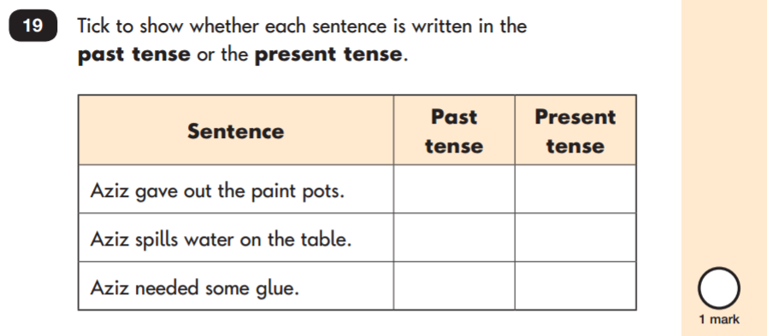
GRAMMAR, PUNCTUATION & SPELLING: SAMPLE QUESTIONS
Grammar, Punctuation and Vocabulary Paper
next page
chapter
menu

Slide 29
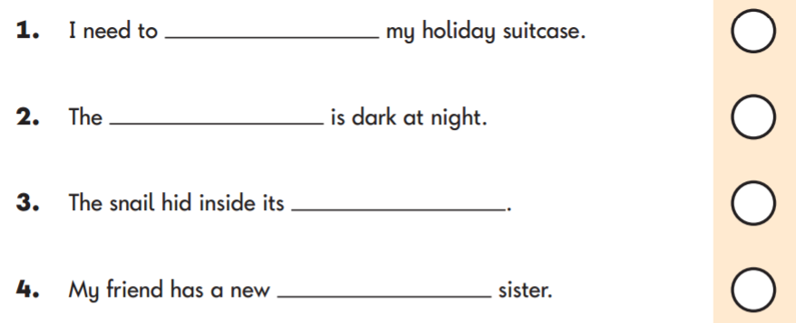
GRAMMAR, PUNCTUATION & SPELLING: SAMPLE QUESTIONS
Spelling Paper
chapter
menu
next page
Within the assessment, the spelling words are read out to the children to fill into the gaps within the sentences. In this example, the missing spelling words are: pack, sky, shell and baby.

Slide 30
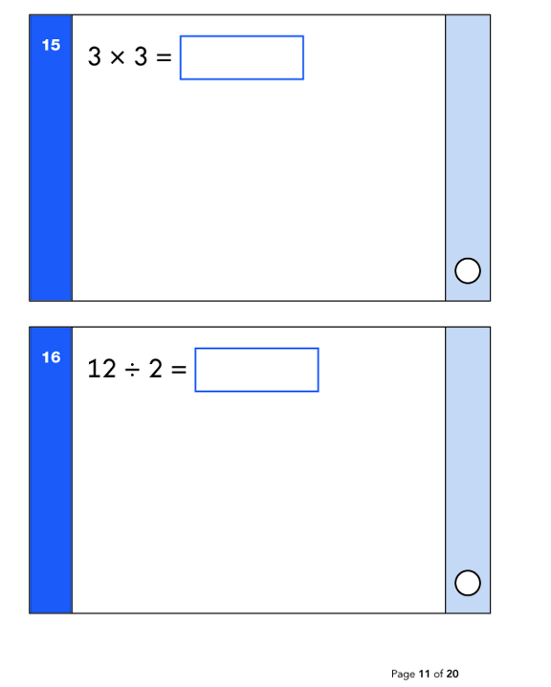
MATHS: SAMPLE QUESTIONS
Maths Paper 1: Arithmetic
chapter
menu
next page

Slide 31
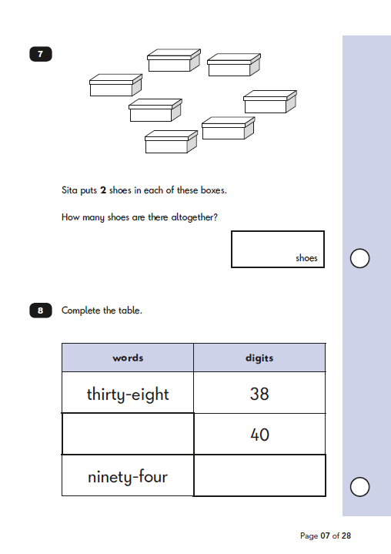
MATHS: SAMPLE QUESTIONS
Maths Paper 2: Reasoning
next page
chapter
menu

Slide 32
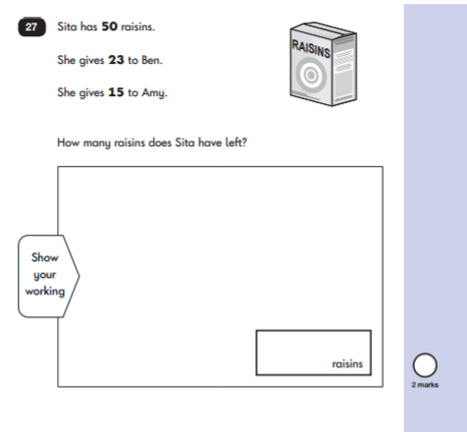
MATHS: SAMPLE QUESTIONS
Maths Paper 2: Reasoning
chapter
menu
next age

